Slide 1
Leading Causes of Death in the United States
Center for Disease Control (CDC) – National Center for Health Statistics (NCHS)

Slide 2
What is the leading cause of death in the United States, and which states will be at the greatest risk in 2019?
RESULTS TO BE USED FOR FUTURE resource ALLOCATION

Slide 3
What is the leading cause of death in the United States?
What is the current trend for the leading cause of death?
Which factors have the greatest impact on the mortality rate?
Which states should be treated as high risk?

Slide 4
What is the leading cause of death in the United States?
Source: Center for Disease Control (CDC) – National Center for Health Statistics (NCHS)
Notes:
Heart disease is leading cause of death. Need to determine if difference with cancer is statistically significant.

Slide 5
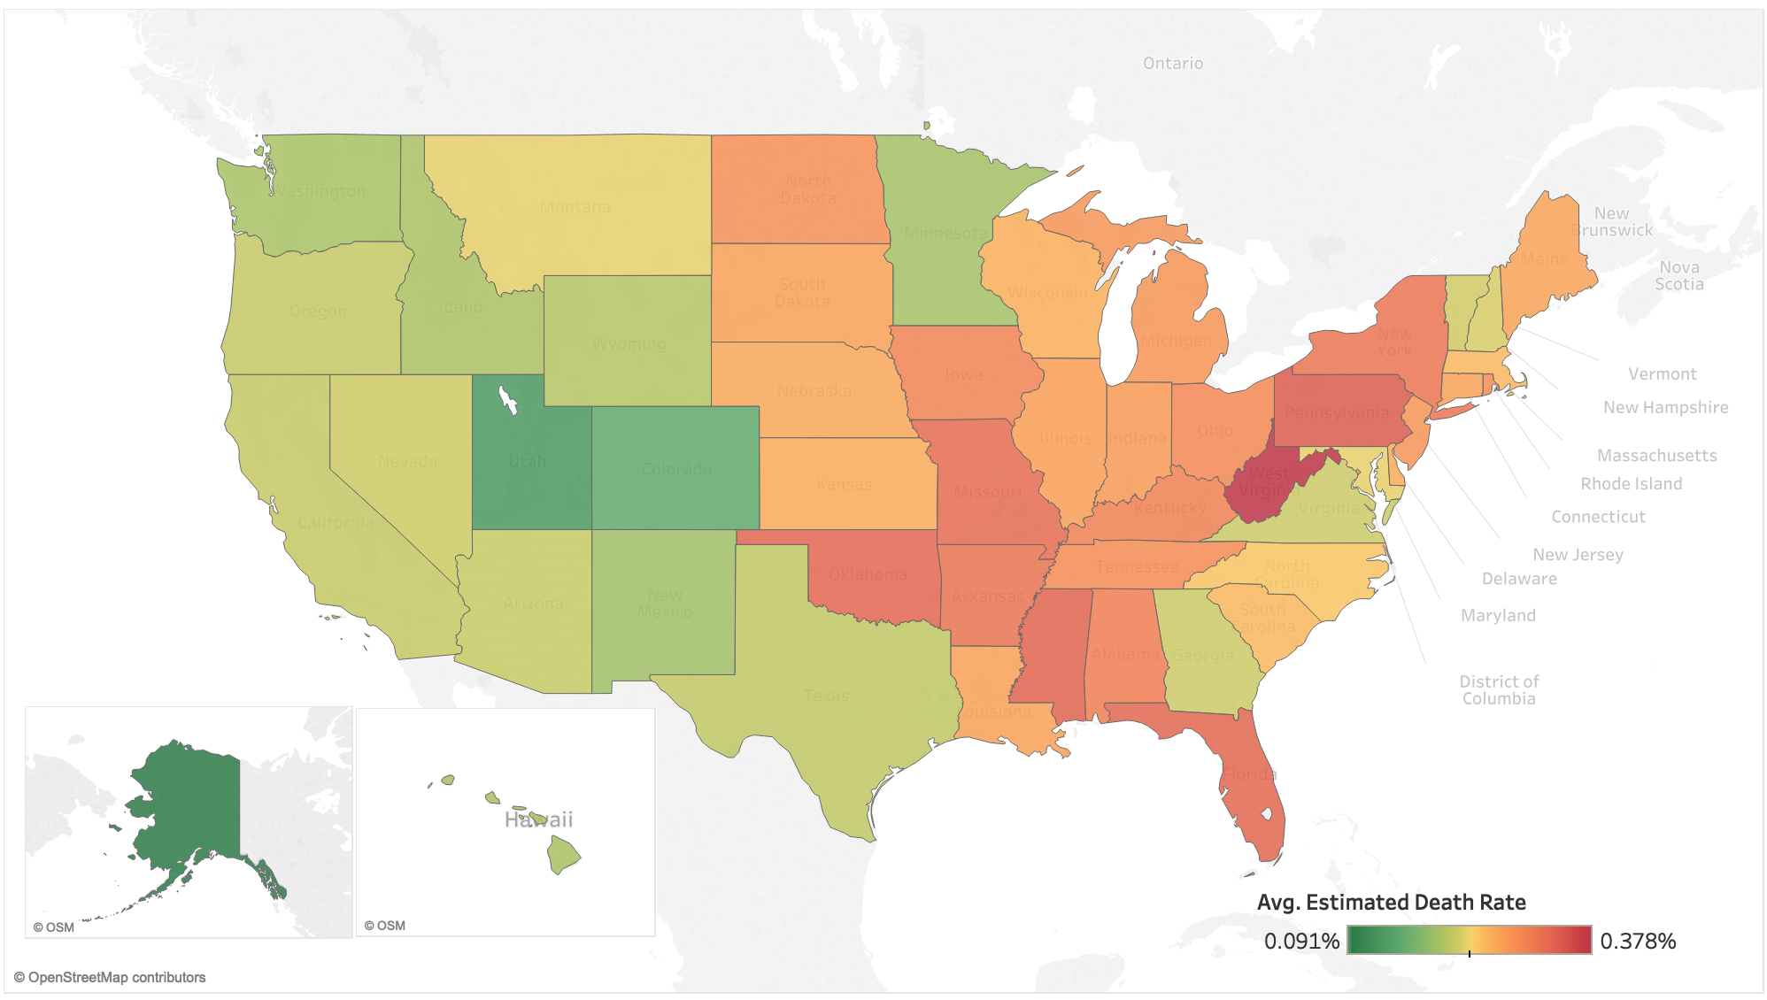
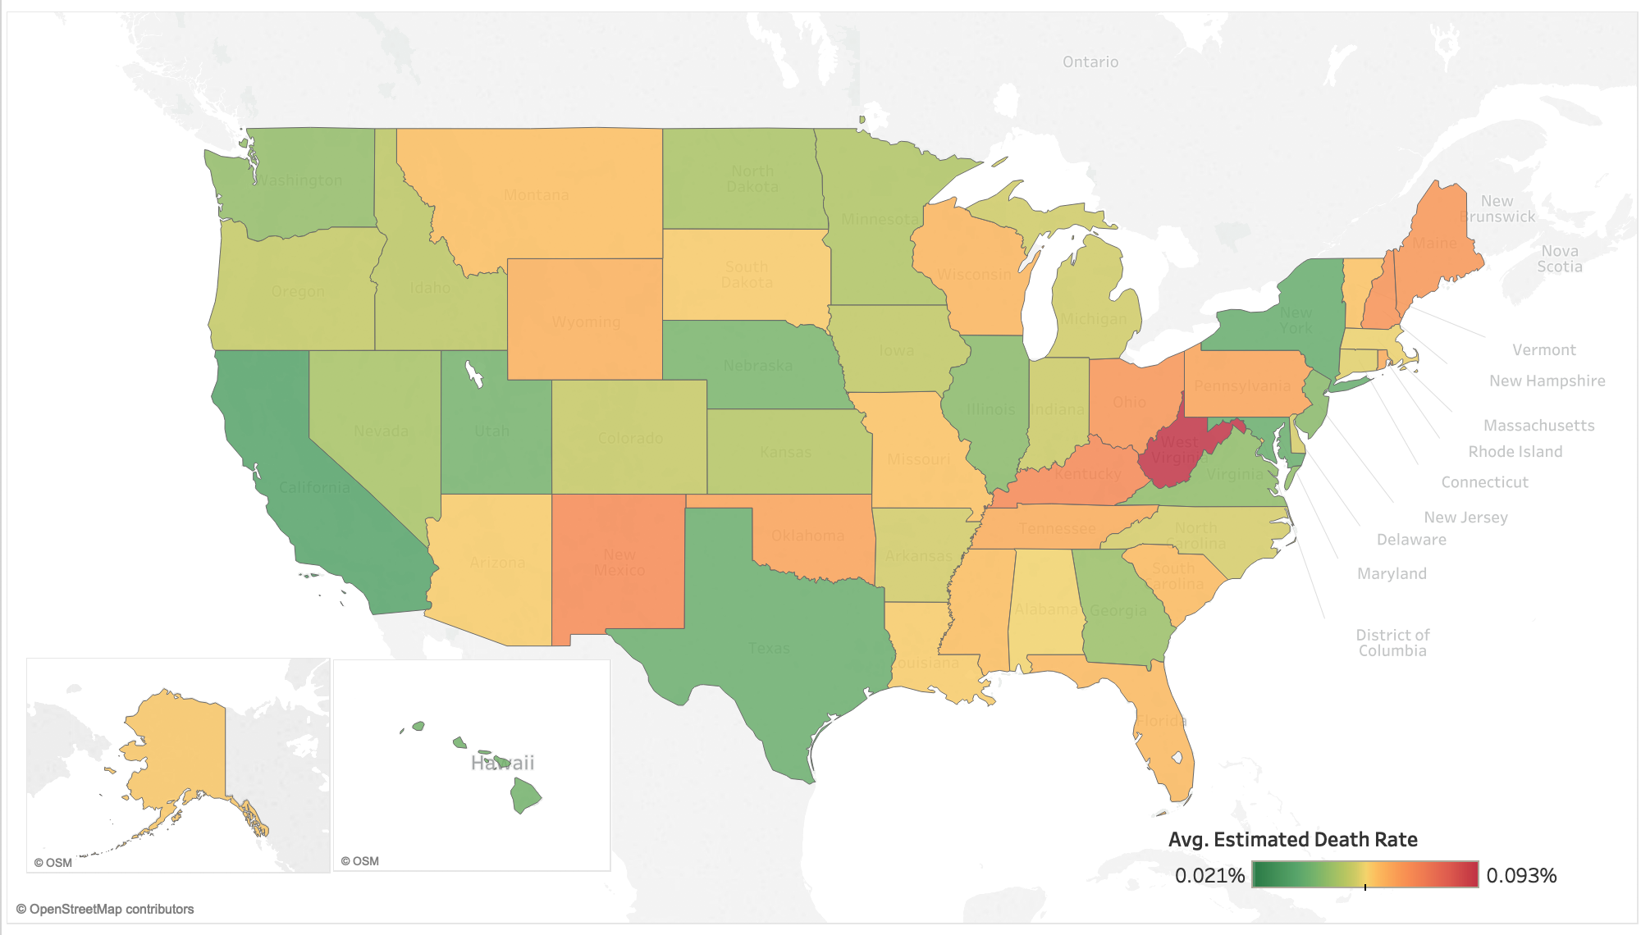
What is the current trend for the leading cause of death?

Slide 6
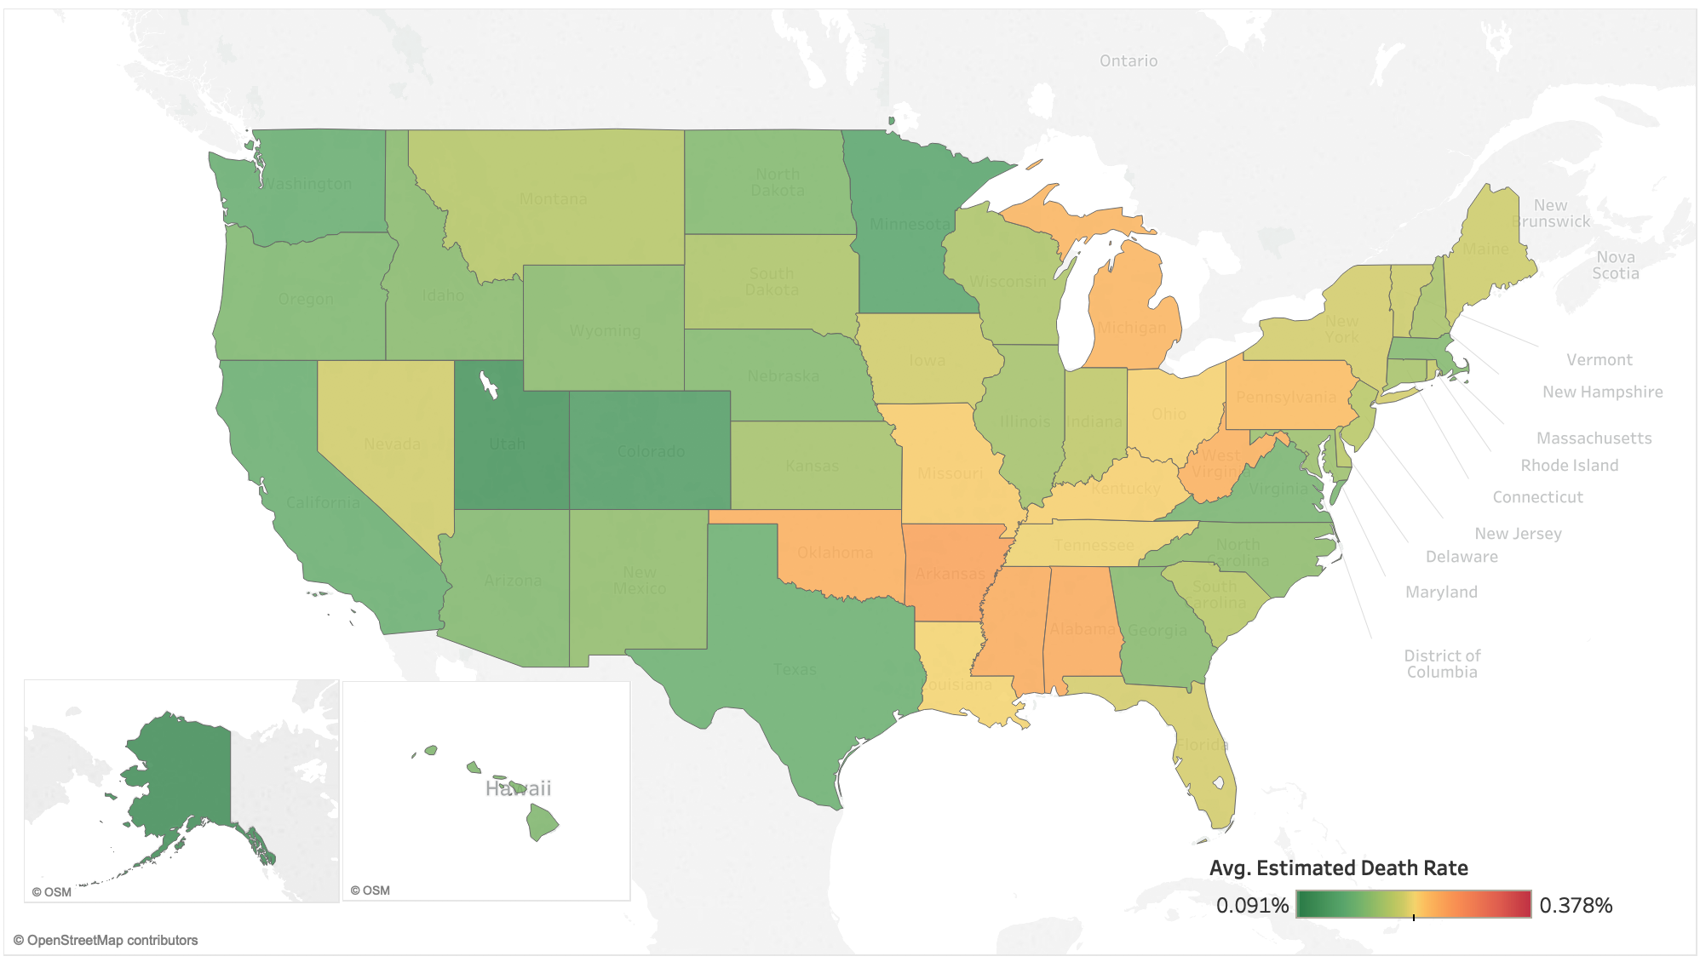
What is the current trend for the leading cause of death?

Slide 7
Which factors have the greatest impact on the mortality rate?
Population Demographics
CDC – NCHS
Alcohol Consumption
National Institute on Alcohol Abuse and Alcoholism
Smoking
United Health Foundation
Notes:
Includes the number of deaths by state from 1999-2016
Includes population data broken down by age group, gender, state, and year from 1999-2017.
Death rate calculated as percentage of total population, not percentage of total deaths.
State size – Self Explanatory
Alcohol consumption measured as average amount of alcohol consumed per capita annually by beverage type (wine, beer, spirits). Broken down by year and state based on alcohol sales and percentage of population 14 years or older.
Smoking numbers represent percentage of population that reported smoking at least 100 cigarettes in their lifetime.

Slide 8
Data Sources
Smoking
United Health Foundation
Notes:
Methodology for calculating smoking population changed in 2012. To account for this change, we used the prior 5 years to estimate an adjustment for 2012 and scale values down…

Slide 9
Data Sources
Smoking
United Health Foundation
Notes:
…see results here.

Slide 10
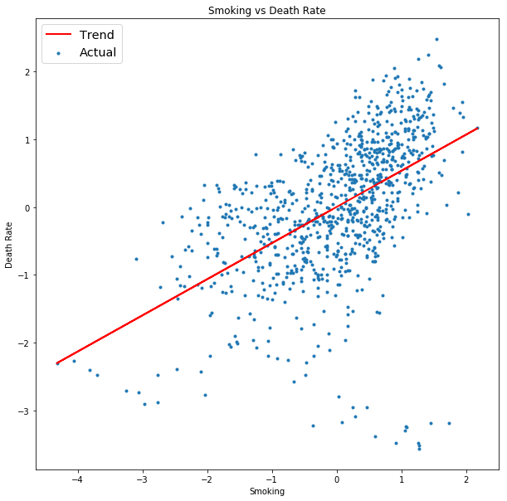
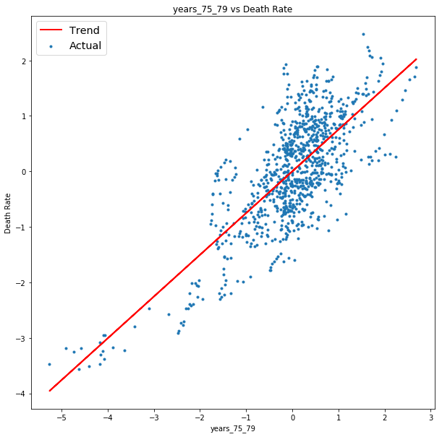
Which factors have the greatest impact on the mortality rate?
% Smokers vs Death Rate
75 – 79 Age Group vs Death Rate
Deaths per Capita
Deaths per Capita
% Smokers
% 75-79 Age Group

Slide 11
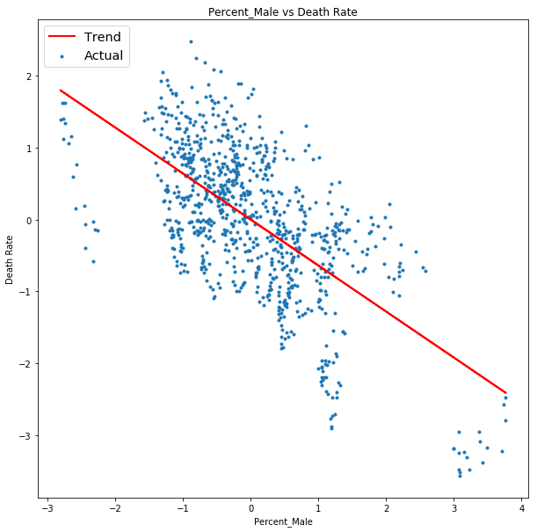
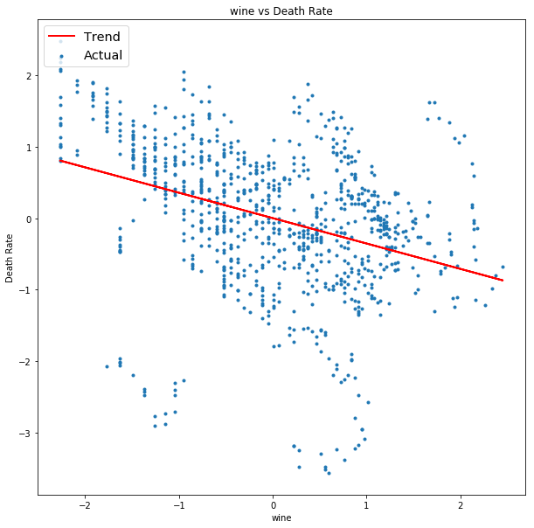
Which factors have the greatest impact on the mortality rate?
% Male vs Death Rate
Wine Consumption vs Death Rate
Deaths per Capita
Deaths per Capita
Male Population
Wine Consumption

Slide 12
Feature Engineering
3 - 5 Year Lagged Predictions
High-Risk Defined as Top 33% of All Results

Slide 13
Making Predictions into the Future

Slide 14
Model Performance

Slide 15
Model Performance

Slide 16
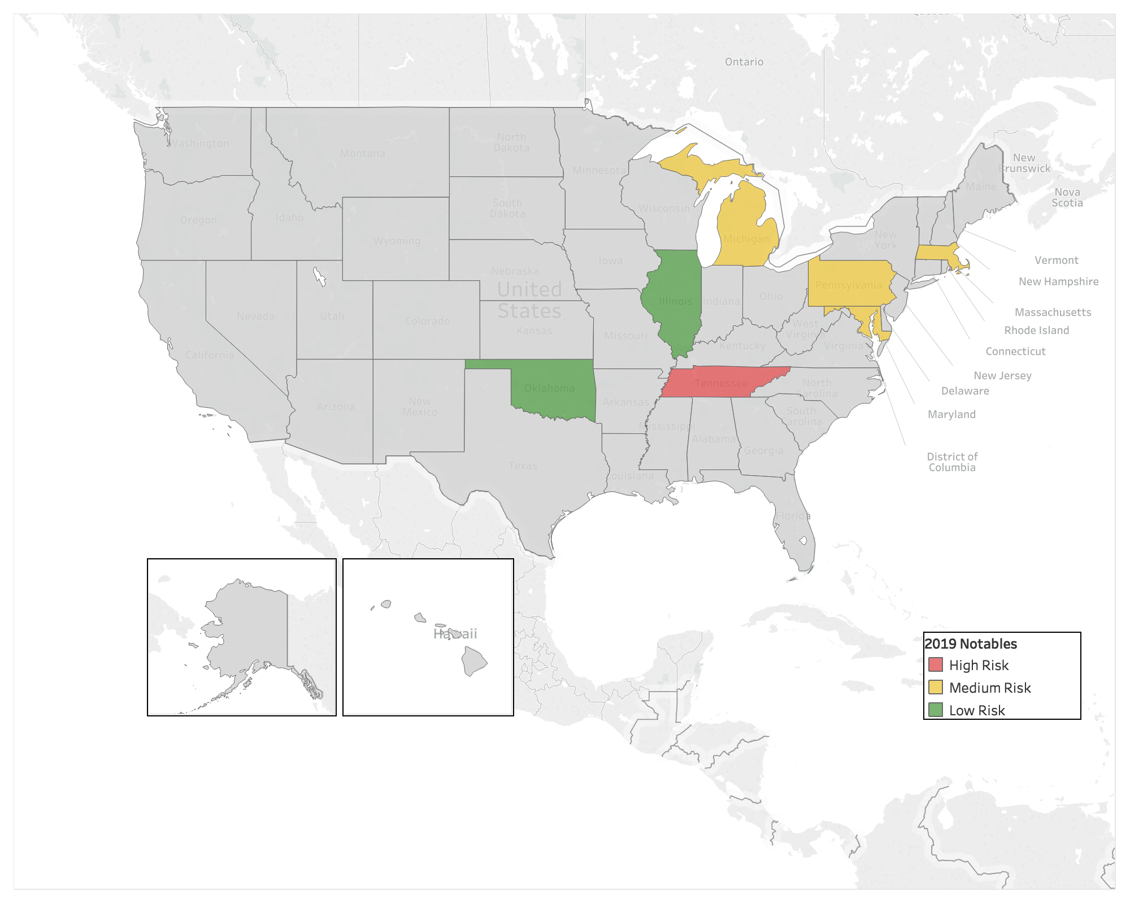
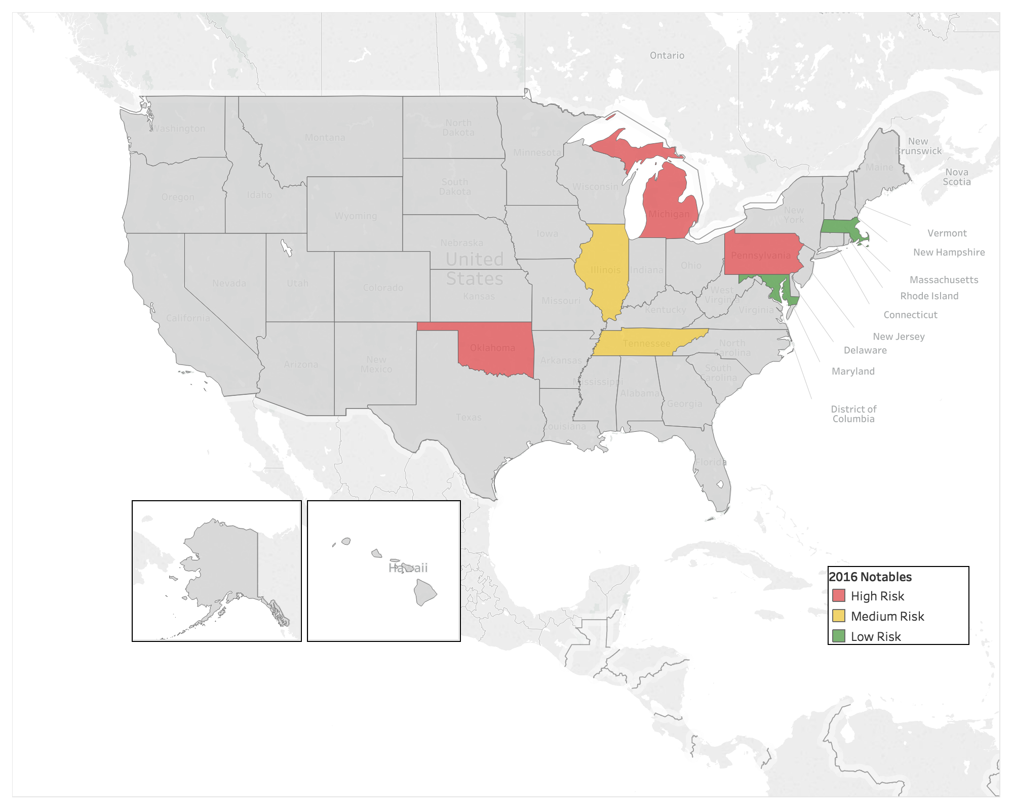
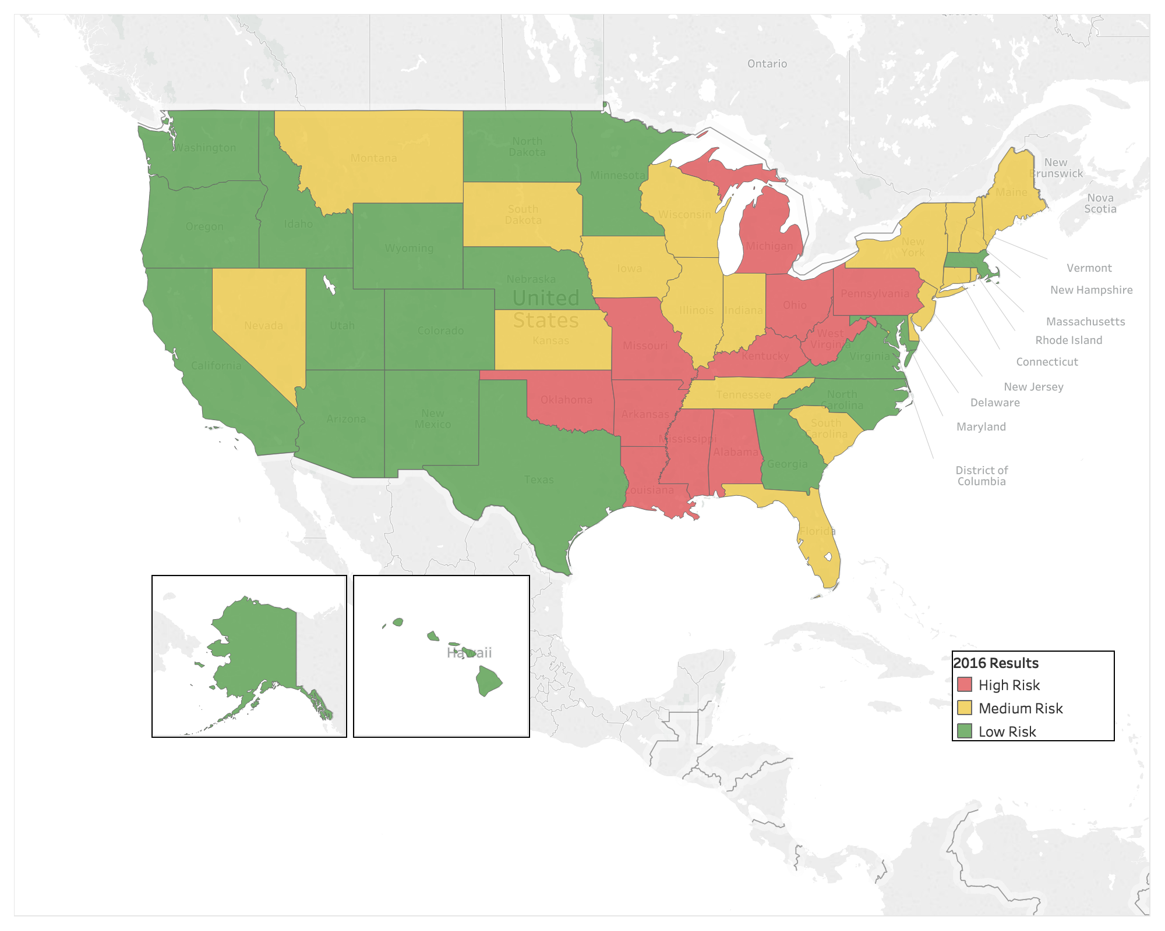

2016
2019
Model Predictions

Slide 17
2016
2019
Oklahoma
High-Risk to Low-Risk in 3 Years
Dramatically Reduced Smoking Rate
Certified Healthy Oklahoma Program
Model Predictions

Slide 18
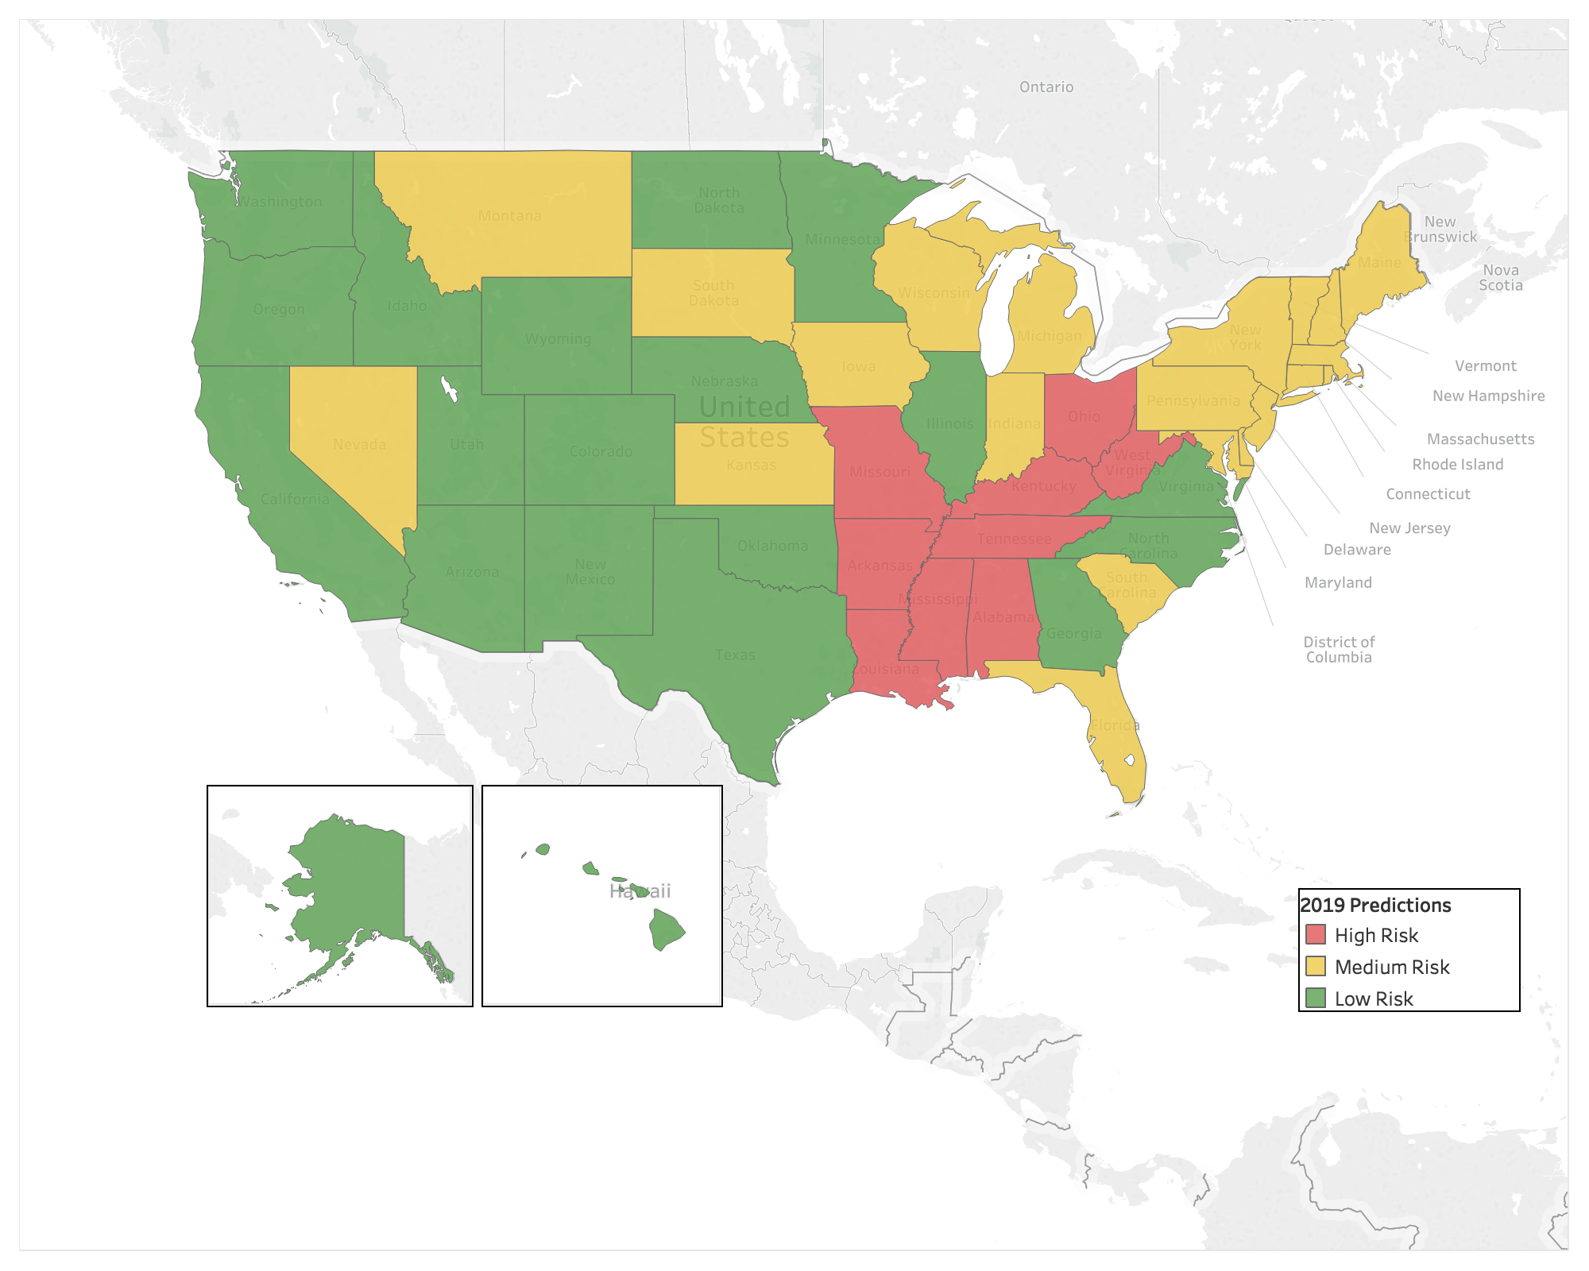
2016
2019
Model Predictions
2019 High-Risk States
Alabama | Missouri
Arkansas | Ohio
Kentucky | West Virginia
Louisiana | Tennessee
Mississippi

Slide 19
Recommendations
Reallocate Funds from Illinois & Oklahoma
Run Awareness Campaigns for Women & Retirees
Anti-Smoking Ad Campaigns

Slide 20
Next Steps
Investigate Primary Results Drivers by State
Gather More Behavioral and Socioeconomic Data
Perform Similar Analysis for Cancer

Slide 21
Questions

